Slide 1
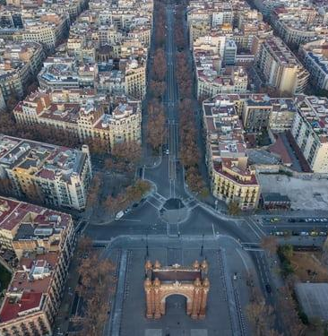
BARCELONA NEIGHBORHOODS
Data Project Week 2
Miguel Vian, Laura Würz & Alona Sorochynska
23.08.2019

Slide 2
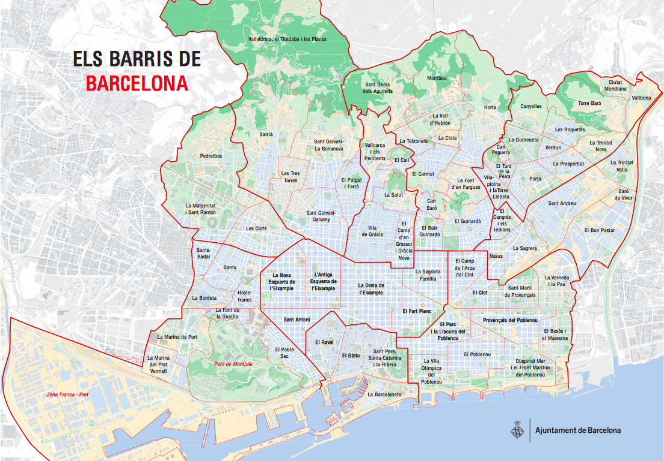

Slide 3
PRESENTATION STRUCTURE
1
RESEARCH QUESTIONS
DATA SOURCES
2
DATA ACCESSING
3
INSIGHTS
4
FUTURE RESEARCH
5
CHALLENGES
6

Slide 4
RESEARCH QUESTIONS
In which neighborhood in Barcelona is unemployment highest?
In which neighborhood in Barcelona is immigrant population the highest?
Is there a relation between immigrants and unemployment in the neighborhoods?
1
2
3

Slide 5
RESEARCH QUESTIONS
In which neighborhood in Barcelona is unemployment highest?
In which neighborhood in Barcelona is immigrant population the highest?
Is there a relation between immigrants and unemployment in the neighborhoods?
1
2
3

Slide 6
RESEARCH QUESTIONS
In which neighborhood in Barcelona is unemployment highest?
In which neighborhood in Barcelona is immigrant population the highest?
Is there a relation between immigrants and unemployment in the neighborhoods?
1
2
3

Slide 7

DATA SOURCES
DATASET ON UNEMPLOYMENT
UNEMPLOYMENT
1
73 Barcelona Neighborhoods
Gender
Years 2015 - 2017
Months
Notes:
Unemployment:
Contains info on:
73 Neighborhoods
Districts
3 Years
Month
Gender

Slide 8

DATA SOURCES
DATASET ON IMMIGRANTS BY NATIONALITY
IMMIGRANTS BY NATIONALITY
2
73 Barcelona Neighborhoods
Nationality
Years 2013 - 2017
Notes:
Contains info on:
73 Neighborhoods
Districts
5 Years
Nationality

Slide 9

DATA SOURCES
DATASET ON BARCELONA POPULATION
POPULATION
3
73 Barcelona neighborhoods
Gender
Years
Age ranges
Notes:
Population:
pop 2015,2016,2017 grouped

Slide 10
DATA SOURCES
UNEMPLOYMENT
1
Notes:
share the same neighborhood ID
Unemployment:
Contains info on:
73 Neighborhoods
Districts
3 Years
Month
Gender
Immigrants by Nat:
Contains info on:
73 Neighborhoods
Districts
5 Years
Nationality
Population:
pop 2015,2016,2017 grouped

Slide 11
DATA SOURCES
UNEMPLOYMENT
IMMIGRANTS BY NATIONALITY
1
2
Notes:
share the same neighborhood ID
Unemployment:
Contains info on:
73 Neighborhoods
Districts
3 Years
Month
Gender
Immigrants by Nat:
Contains info on:
73 Neighborhoods
Districts
5 Years
Nationality
Population:
pop 2015,2016,2017 grouped

Slide 12
DATA SOURCES
UNEMPLOYMENT
IMMIGRANTS BY NATIONALITY
POPULATION
1
2
3
Notes:
share the same neighborhood ID

Slide 13
DATA SOURCES
UNEMPLOYMENT
IMMIGRANTS BY NATIONALITY
NEIGHBORHOOD
ID
POPULATION
POPULATION
1
2
3
Notes:
share the same neighborhood ID
Immigrants by Nat:
Contains info on:
73 Neighborhoods
Districts
5 Years
Nationality
Population:
pop 2015,2016,2017 grouped

Slide 14
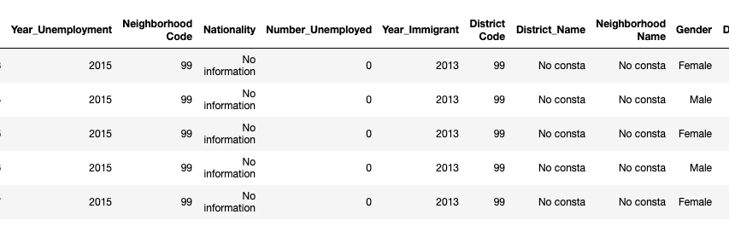
DATA ACCESSING
Data cleaning
UNEMPLOYMENT DATASET
kept January to easily match other datasets
removed all non registered unemployment
IMMIGRATION DATASET
dropped approx. 700 rows out of 35224 (1.97%) without info on neighborhoods, nationality or where Nationality = Spain
POPULATION DATASET
dropped all age ranges that were not within the working age (29930 out of
70080, 42%)
Notes:
Data cleaning
NaN
No Info
removed 1 from unemployment
c. removed District columns (because no additional value to us) from both Datasets
d. removed Months from unemployment
Immigrants
# Dropped 473 rows with 99 values
# Dropped 222 rows where no info on Nationality
Data manipulation
check/adjust types
rename columns
reorder columns
filtering
Data analysis

Slide 15
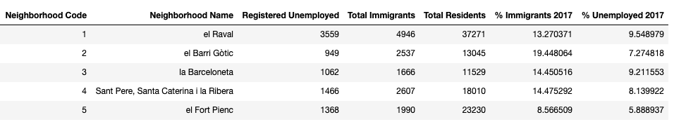
DATA ACCESSING
Data manipulation
renaming columns that were not meaningful or comparable over datasets
reorder columns
merge datasets together
merged_unemp_immigr = unemployment_agg.merge(immigrants_agg, on= ['Neighborhood Code'])
Barcelona_Neighborhoods = merged_unemp_immigr.merge(population_agg, on= ['Neighborhood Code'])

Slide 16
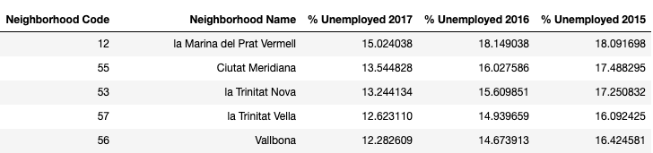
ANSWERS TO OUR RESEARCH QUESTIONS
In which neighborhood in Barcelona is unemployment highest?
1
Notes:
→ Consistent over all 3 years
not very meaningful if we do not know the total population

Slide 17
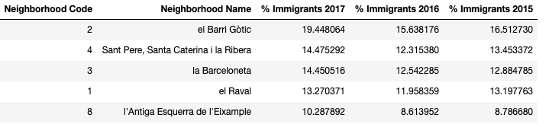
ANSWERS TO OUR RESEARCH QUESTIONS
In which neighborhood in Barcelona is immigrant population the highest?
2
Notes:
table showing all years

Slide 18
Immigrants
Unemployment

Slide 19
ANSWERS TO OUR RESEARCH QUESTIONS
Is there a relation between immigrants and unemployment?
3

Slide 20
MAIN INSIGHTS
The neighborhood with the highest unemployment rate is La Marina del Prat Vermell
TOP 5 unemployment neighborhoods consistent over years 2015,2016, & 2017
Unemployment rate decreasing throughout the years in the neighborhoods
The neighborhood with the highest immigration rate is El Barri Gotic
TOP 5 immigrant neighborhoods almost consistent over years 2015,2016, & 2017
Immigrants increasing over the years in the neighborhoods
Immigrants and unemployment do not seem to be related with regards to the neighborhoods
1
2
3

Slide 21
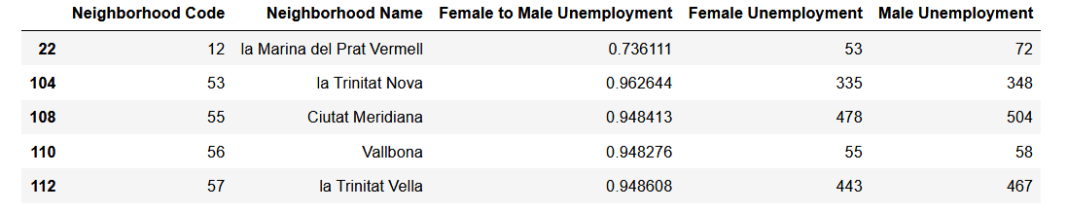
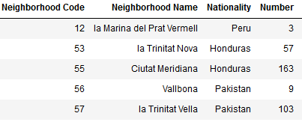
MORE INSIGHTS AND FUTURE RESEARCH
Gender differences in unemployment
Nationality

Slide 22
FUTURE RESEARCH
Visualization on map
Public Transportation in Neighborhoods
Schools in Neighborhood
How to decrease unemployment in affected neighborhoods
...

Slide 23
CHALLENGES...

Slide 24

QUESTIONS?

